Slide 1


KPRIET
Image Classification
Using Large Dataset
Presented By
Sibiram T
Kiruba K

Slide 2



What is Classification
Classification is a supervised machine learning task in which a model learns a mapping function from input data to a predefined set of discrete class labels. Given an input sample, the classifier extracts relevant features and assigns the sample to the class with the highest predicted probability based on learned decision boundaries.
Mathematically, classification aims to learn a function:
$$f\left(x\right):X→Y$$
Where
$X$ represents the input feature space (e.g., images, frames, signals)
$Y$ represents a finite set of class labels
In deep learning–based image classification, convolutional neural networks (CNNs) automatically learn hierarchical feature representations (edges, textures, shapes, and semantic patterns) and perform class prediction using a softmax probability distribution.

Slide 3
Introduction
With the growing amount of underwater image data, manual classification is no longer feasible. Automated systems are needed to classify large volumes of data efficiently, where handling scale is more important than perfect accuracy on individual images.
Previous Work
Earlier teams worked on underwater coral classification using different CNN models. A team using Efficient Net achieved classification across a large number of coral types, while another team using Mobile Net obtained reliable results for a smaller set of classes.
This variation in outcomes indicates the need for a more scalable and structured approach that can handle large datasets effectively. The current work aims to extend and unify these efforts by emphasizing robust data preprocessing and scalable classification rather than focusing solely on accuracy.

Slide 4

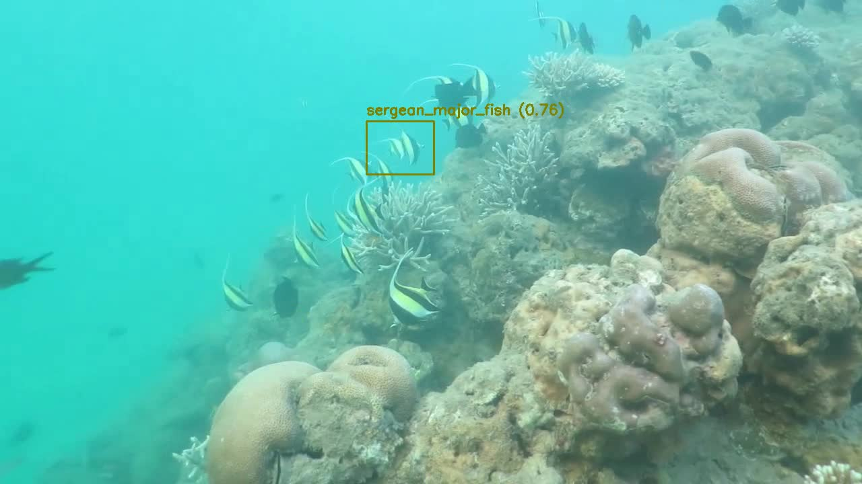
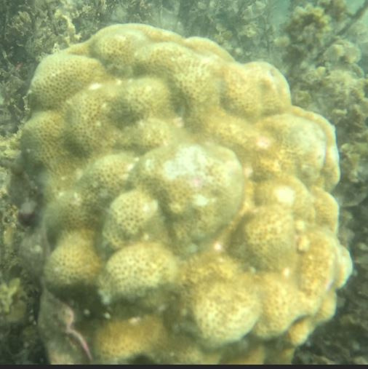
About previous work

Slide 5
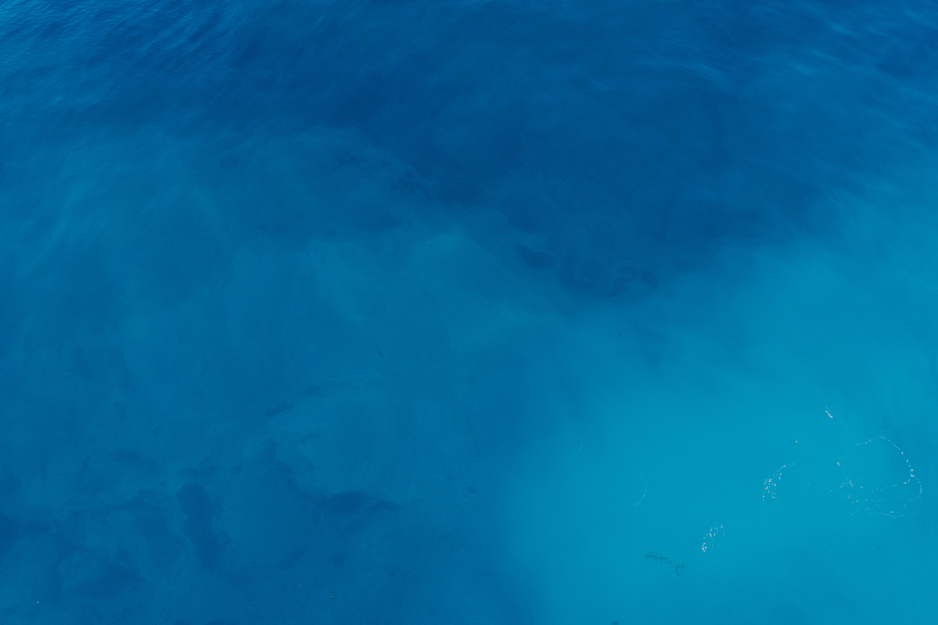
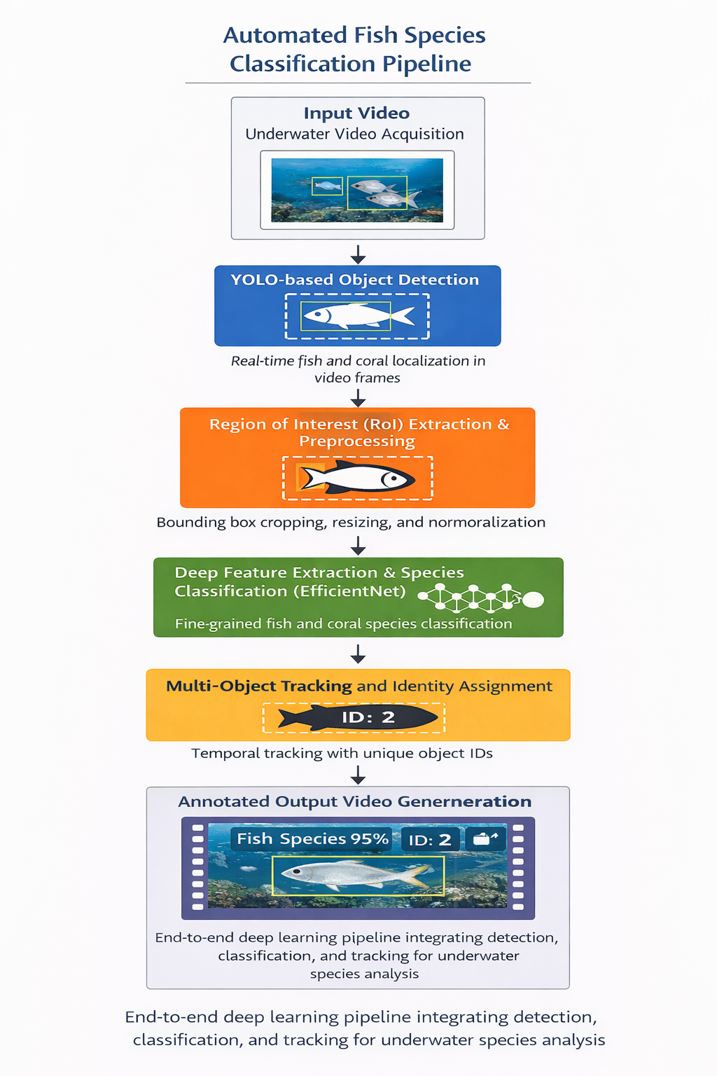
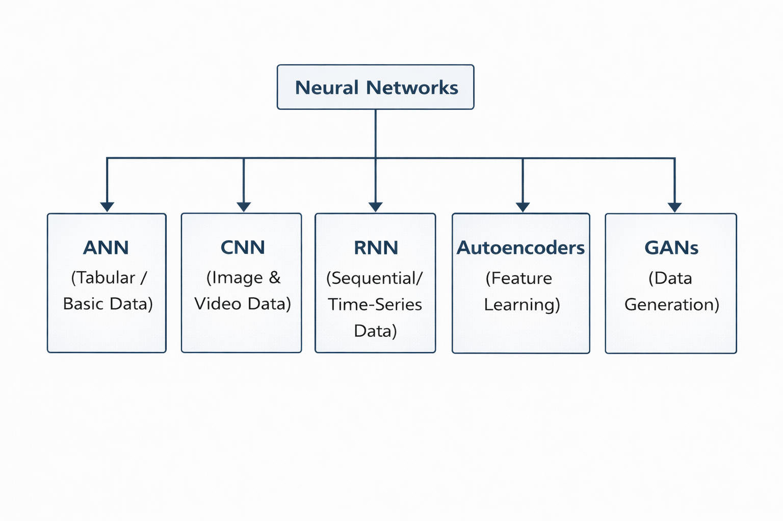
Architecture
CNN was chosen for its ability to effectively learn visual features from complex underwater images, while YOLOv8 was selected for its fast and robust object detection capability in challenging underwater environments. Together, they form an efficient and scalable framework suitable for large underwater datasets, enabling reliable detection and classification of fish and coral with minimal computational overhead.

Slide 6
Why Efficient Net?
Efficient Net was selected as the primary classification model due to its optimal balance between accuracy, efficiency, and scalability, which is critical for underwater video-based species classification.
Compound Scaling
Fine-Grained Feature Extraction
High Accuracy with Fewer Parameters
Robustness to Underwater Conditions
Efficient Inference for Video Processing.
Model | Strength | Limitation
MobileNet | Lightweight, fast | Lower accuracy for fine-grained species
ResNet | Strong representation | High computation, overfitting risk
EfficientNet | Best fit for this project | Best fit for this project
“Mobile Net is optimised for speed, Res Net for depth, but Efficient Net optimises all dimensions together, which makes it more suitable for fine-grained underwater classification.”

Slide 7




Fish Family Cropping
GROUP 1
GROUP 2
GROUP 3
Using a feature-based unsupervised approach, approximately 90 fish families were formed by clustering detected fish images based on color, texture, and size characteristics. While some misclassification is observed due to overlapping fish, background inclusion, and visual similarity across species, several families show clear intra-family visual consistency, as evident from the clustered images. These results demonstrate the effectiveness of automated fish family grouping from video data without prior labeling, while also highlighting areas for future refinement.

Slide 8
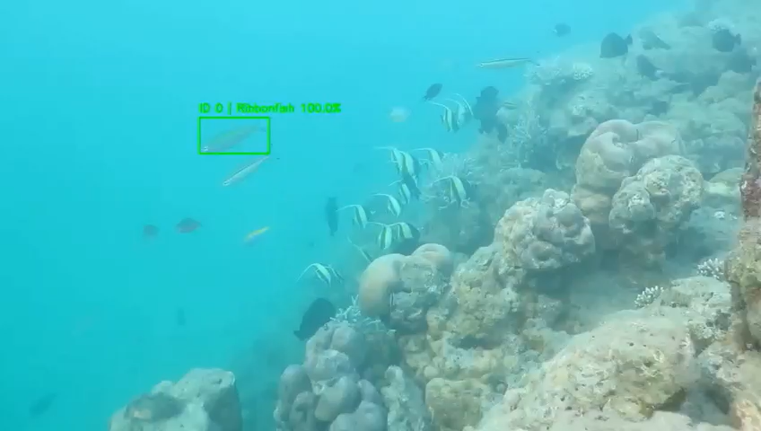
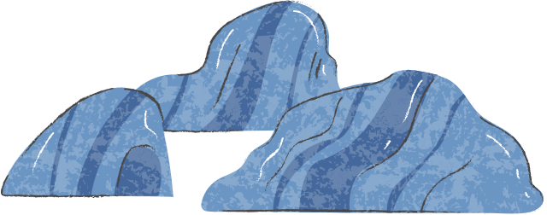
Output(Efficient Net)

Slide 9
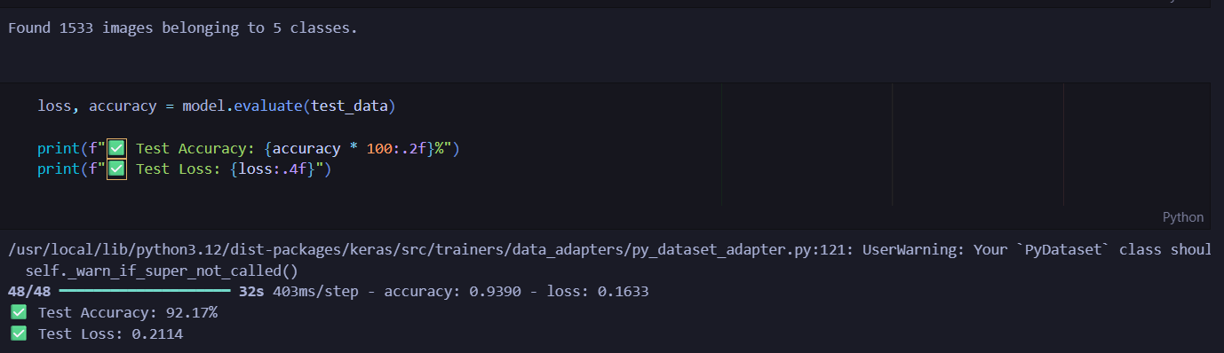
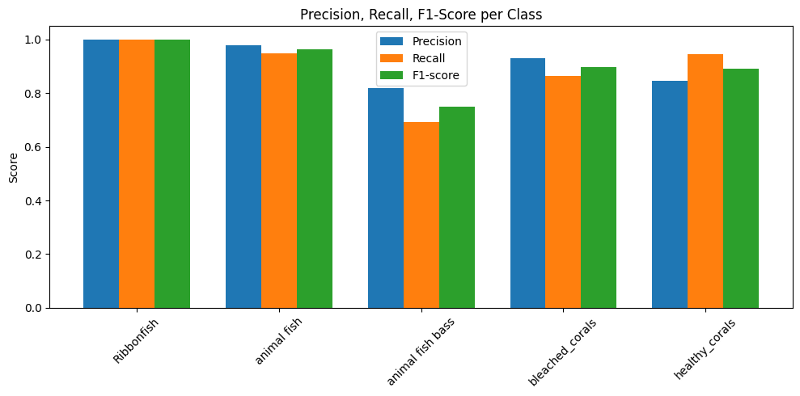
Metrix

Slide 10
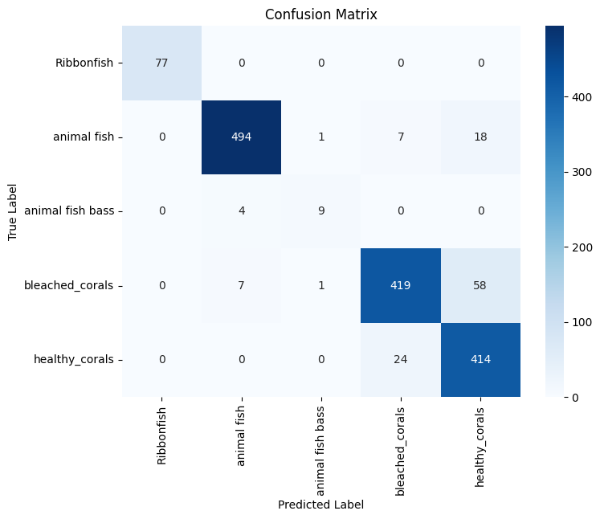
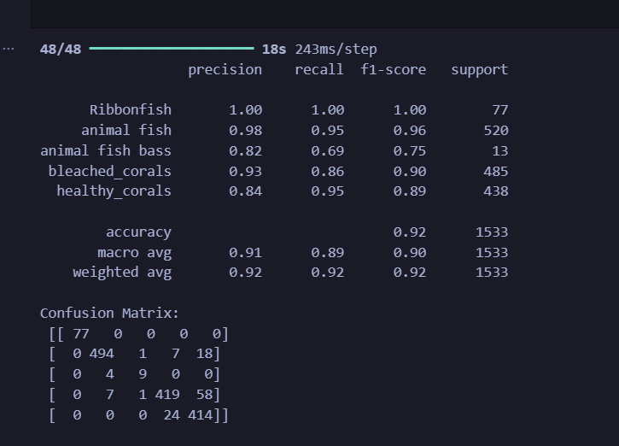
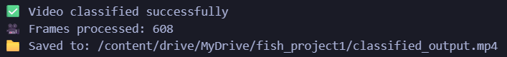
Output(MobileNet)

Slide 11
Issues Faced
Same fish family was split into many clusters due to small visual changes
Lighting and background (coral) strongly affected color and texture features
Overlapping fish caused incorrect feature extraction
Handcrafted features lack biological understanding of fish shape and fins
Clustering results were highly sensitive to parameters
Method To Overcome
Use YOLOv8 to accurately detect and crop individual fish from video
Extract deep features using Efficient Net, capturing biological shape and structure
Perform unsupervised clustering (DBSCAN) on deep features to form fish families
Reduce background and lighting effects through robust CNN embeddings
Achieve more biologically meaningful and stable fish family grouping
Tried with enhanced video using sobel feature extraction
This method uses deep CNN features to achieve more accurate and biologically consistent fish family classification.

Slide 12
Work Progress
Collected underwater videos and extracted frames
Annotated fish and coral manually using bounding boxes
Used YOLO to detect fish and coral in videos
Grouped detected objects into family-level categories
Cropped detected fish and coral from videos
Combined cropped data with existing and online datasets
Trained Efficient Net model to classify different fish and coral species
Generated output video with bounding boxes, class name, and confidence
Upcoming Work:
Combine fish and coral models into one unified system
Improve accuracy for similar-looking species
Add more species and larger datasets
Optimize the system for real-time underwater monitoring
“The system demonstrates a practical fusion of object detection and deep learning-based classification,
The proposed system can be extended into a real-time, multi-species underwater monitoring framework.”

Slide 13
KPRIET
Thank You!

